Slide 1
Linear Regression
And Its Cousins
Lisa SzYdziak and Diego Correa
11/2/21

Slide 2

Linear Regression Model
We want to fit a dependent variable, Y and predictor variables, x1, x2, x3, etc., that is linear in the parameters.
HOW? Seek parameter estimates where SSE is minimized
TYPES OF MODELS
Ordinary Linear regression
Partial Least Squares
Ridge Regression
Lasso
Elastic net
Estimates with min bias
Penalized models
Estimates with min variance

Slide 3
Linear Regression – highly interpretable
ß-hat =(X^{T}X)⁻¹X^{T}y
Vector of COEFFICIENTS
Coefficient: A predictor with a coefficient of 2.5 means for every unit increase in the predictor, the response variable would increase by 2.5.
SE of coefficients
Allow for statistical significance of each predictor
Augment with quadratic, cubic and interaction terms.

Slide 4
Linear Regression….continued
ß- hat – vector of coefficients
Estimates that minimize SSE (least biased)
Check for Multicollinearity (VIF) – remove some correlated variables.
If predictors > observations
➔employ PCA to reduce dimensionality.
➔Partial Least Squares
➔Penalized methods: Lasso, ridge, elastic net

Slide 5
Steps to follow
Remove skewness, transform variables
Scatter plot of predictor variables vs response.
Significant between-predictor correlation? PCA
Correlation structure – strong correlations =>
Pre-process to remove variables

Slide 6
More Diagnostics
The predicted versus residual plot should exhibit no patterns
Curvature in this plot indicates underlying relationship not linear, may need quadratic, cubic
Leverage points or influential outliers may be problematic – need further investigation
Use alternative to SSE – Huber function uses squared residuals when small and a simple difference when above a threshold.

Slide 7
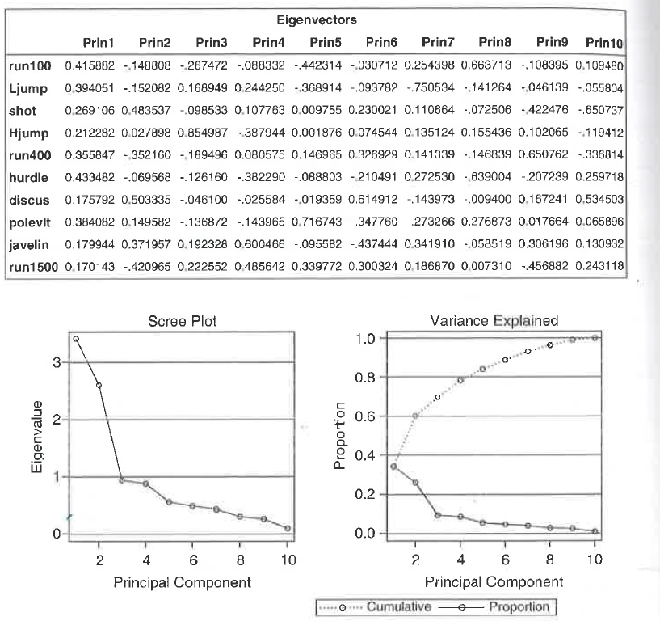



Principal component Analysis*
PCA – Example
Decathlon
Prin 1 – overall performance
Prin 2 – Strength events
PCR uses PCA components (selected without response variable, unsupervised)
Method may be flawed if variability in predictors not related to variability in response.
Source: *A Handbook of Statistical Analyses using SAS, 3rd Ed., Der & Everitt

Slide 8
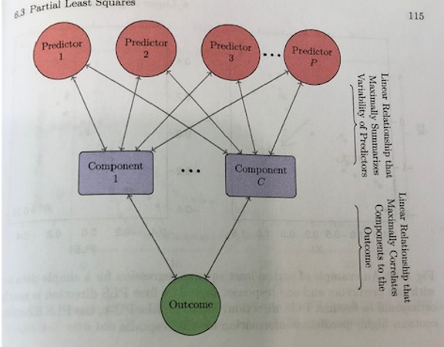
Partial Least Squares
Use when correlated predictors
NIPALS algorithm (Nonlinear iterative partial least squares)
Components - Maximize variability of predictors
Outcome – Maximally correlates to outcome, SUPERVISED
PLS – predictor dimension reduction & predictor relationship with response

Slide 9
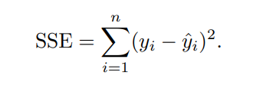
Penalized Models
OLS produces coefficients with low variance and unbiased
Mean Square Error (MSE) is a combination of variance and bias
MSEs can become smaller by allowing parameter estimates to be biased
One method of creating biased regression models is to add penalty to the sum of squared errors.
OLS regression finds parameters to minimize the SSE
Overfitting or collinearity in parameter estimates may become inflated.
Control the magnitude by adding a penalty to SSE

Slide 10
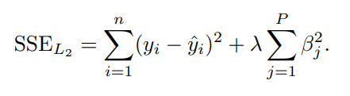
Ridge Regression
Ridge Regression adds a penalty on the sum of squared regression parameters
L₂ = second-order penalty (i.e., the square)
Penalty effect of this equation is that the parameter estimate only become large when there is a proportional reduction in SSE.
This method shrinks the estimates towards 0 as the λ penalty becomes large. Coefficients do not reach 0 for any penalty (i.e. no feature selection).
Sacrificing bias results in reduce variance and overall MSE

Slide 11
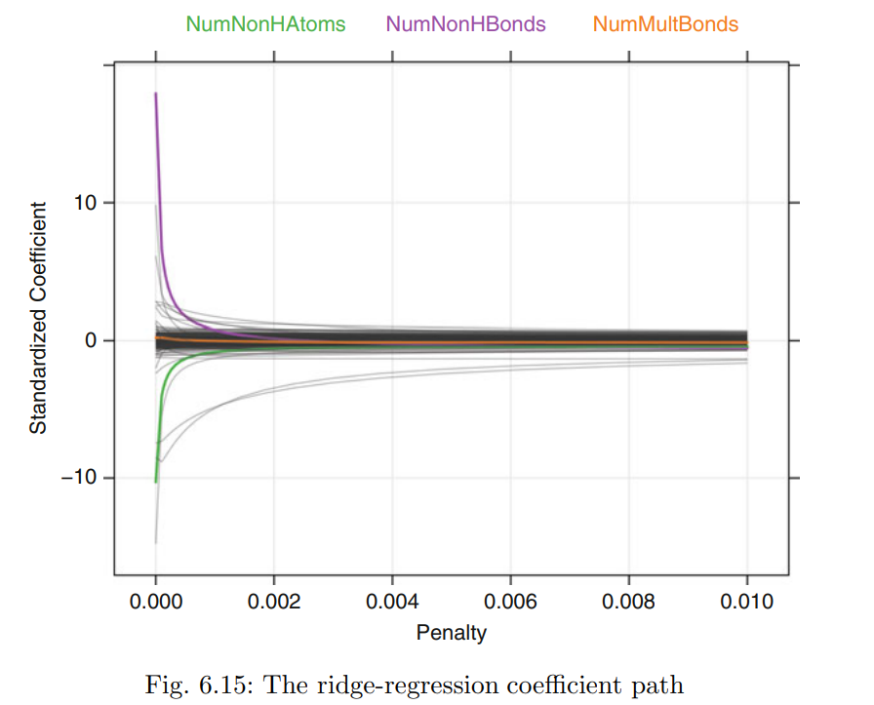
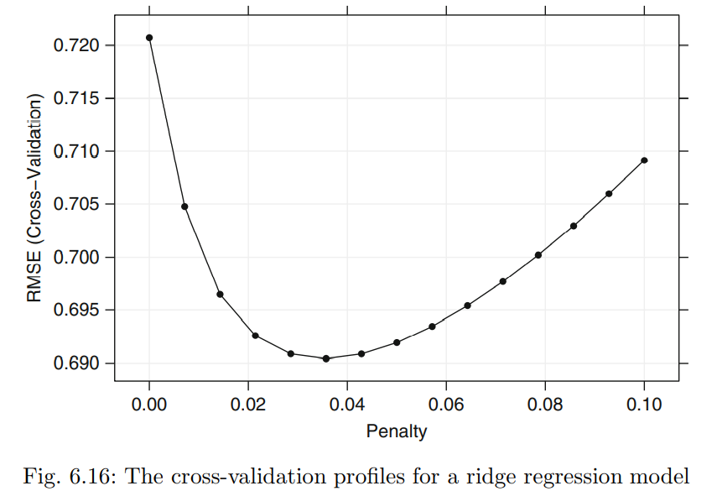
Ridge regression

Slide 12
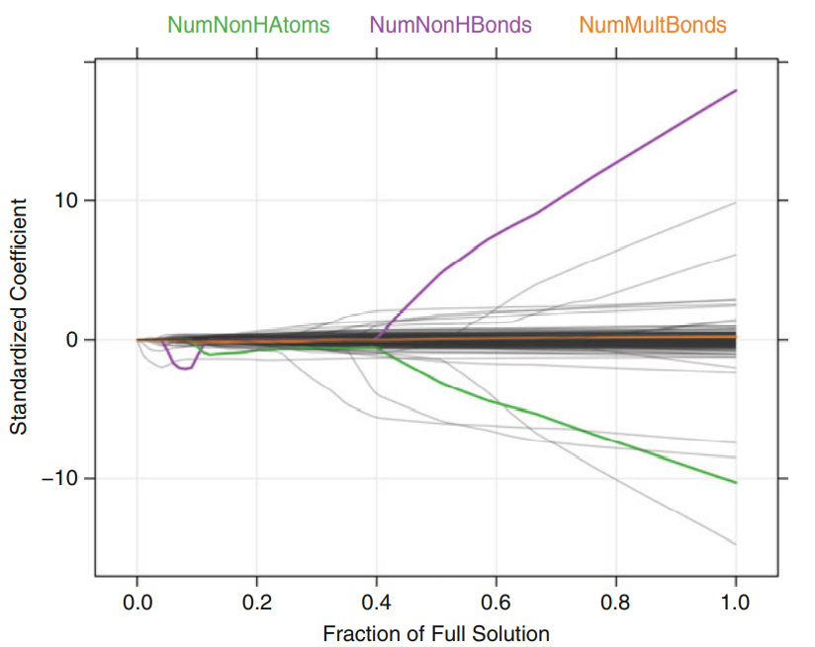
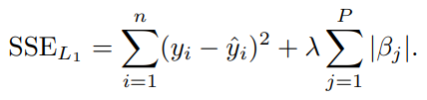
Lasso regression
Least absolute shrinkage and selection operator model (Lasso) uses a similar penalty to ridge regression.
Penalizing absolute values actually set 0 for some value of λ (i.e. feature selection).

Slide 13
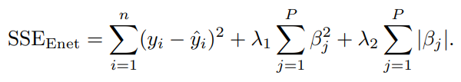
Elastic Model
A generalization of the lasso model is the elastic net.
This model combines the two types of penalties
This model enables the effective regularization (ridge regression) with feature selection (lasso).
Zous and Hastie suggest that this model will more effectively deal with groups of high correlated predictors.

